Slide 1
BioTransformerDB
A database of small molecule metabolism data

Slide 2
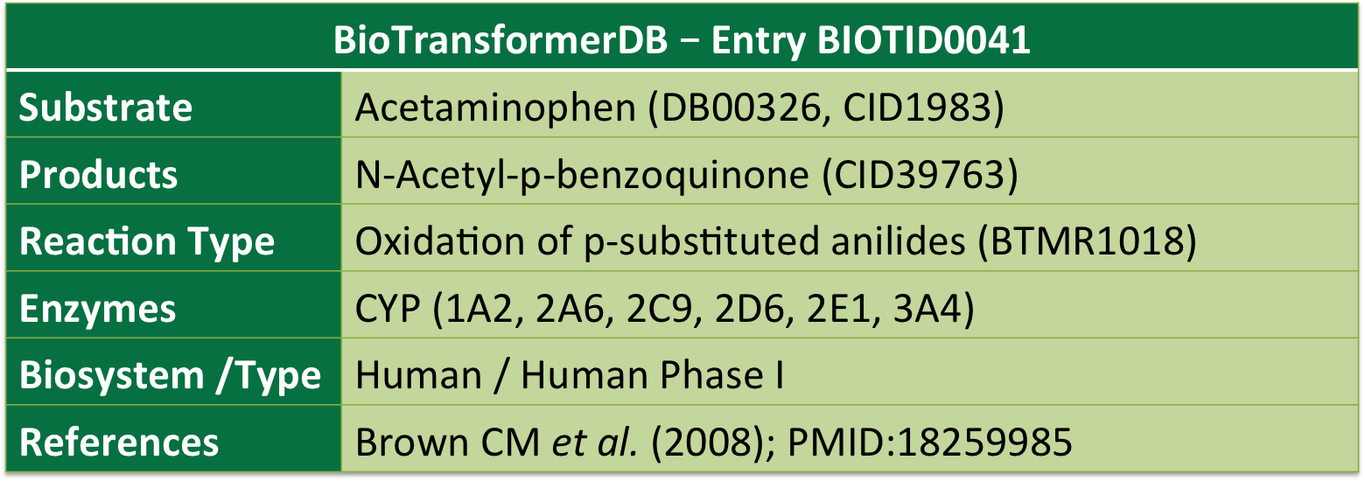
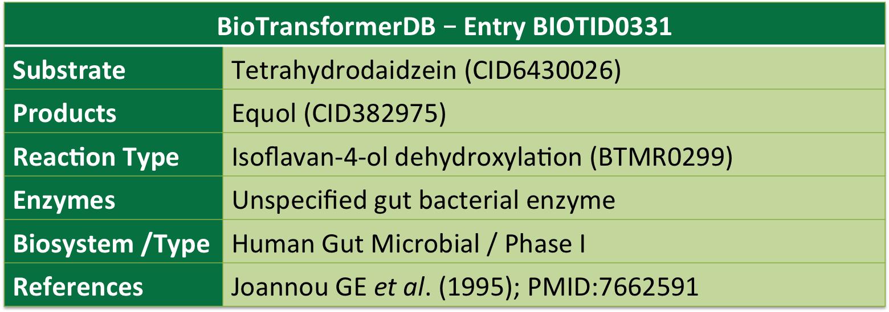
What is BioTransformerDB ?
A
Acetaminophen
NAPQI
B
Tetrahydrodaidzein
Equol
BioTransformerDB:
Covers human (CYP450, phase II), and human gut microbial metabolism (phase I-II).
Contains 1200+ biotransformations, 2,800+ enzyme-reactant associations, and 1,300+ external database identifiers for 1,500+ compounds.
Notes:
BioTransformer is available in JSON

Slide 3
Current status ?
Currently, BioTransformerDB still lacks a number of information:
A large number of compounds are partially annotated only
They lack some metabolites, and data about the reactions leading to those metabolites
A number of metabolites for which metabolism is known need to be added to the database
We have compiled a list of such compounds, with information about what CYP450 enzymes metabolize them
All compounds lack information about their Sites of Metabolism
We need to use the literature to finish the annotation
Notes:
BioTransformer is available in JSON

Slide 4
Our current task
We need to use the literature to finish the annotation
The current task consists of completing the annotation of small molecule metabolism for ~900 substrates.
It will consist of:
Finding pairs of enzyme/substrates, and the resulting metabolites
Identifying the sites of metabolism, and the reaction types
Saving the structures of substrates, and the relevant info ( and their metabolites, in a later stage) in a SDF file.
Notes:
Take the 680 dataset,

Slide 5
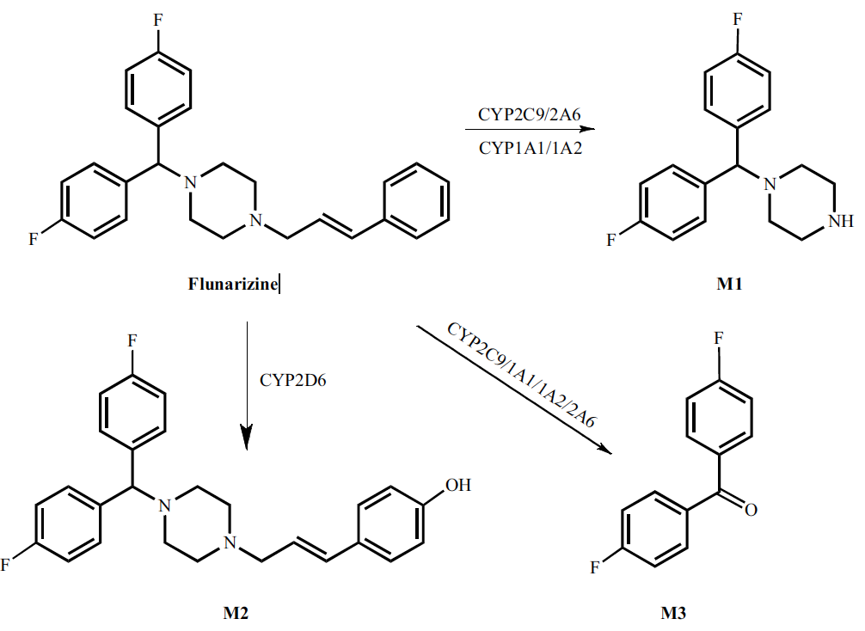
Some Definitions
What is a site of metabolism? A site of metabolism or (SoM) describe an atom that is the center of a metabolic reaction transforming a molecule.
What is a reaction type? It simply defines the type of a metabolic reaction that occurs. E.g.: aromatic hydroxylation, N-dealkylation, etc.
N-dealkylation
Aromatic Hydroxylation
Notes:
BioTransformer is available in JSON

Slide 6
What are CYP450s?
Cytochromes P450 (CYPs) are proteins of the superfamily containing heme as a cofactor and, therefore, are hemoproteins.
CYPs are the major enzymes involved in drug metabolism, accounting for about 75% of the total metabolism. Most drugs undergo deactivation by CYPs, either directly or by facilitated excretion from the body. Also, many substances are bioactivated by CYPs to form their active compounds.
We will be focusing on the CYP1, CYP2, and CYP3 families, especially on 9 isozymes:
1A2, 2A6, 2B6, 2C8, 2C9, 2C19, 2D6, 2E1, 3A4
In some cases, relevant info can be accessible for 1A1, 1B1, and also 3A5, and 3A7
Notes:
BioTransformer is available in JSON

Slide 7
The annotation process
I will provide a number of SDF files:
Our reference SDF with structural information for > 800 compounds, and 3D coordinates
The list will have fields to be filled out in a format that I will specify
An SDF file with 680 compounds and SoM information that were compiled by another group ( for the RS-Predictor) years ago.
This file contains a list of SoMs for all compounds, but appears to be incomplete, and also appear to have some issues
A Google doc entitled “CYP450_metabolism_clean_May2”, which contains several CYP450 biotransformations for several hundreds of compounds
From each reaction, one could see the structure of the substrate, and product, and thus identify the SoMs
A Google file with some info about what enzyme metabolize any of then 800+ structure
Notes:
BioTransformer is available in JSON

Slide 8
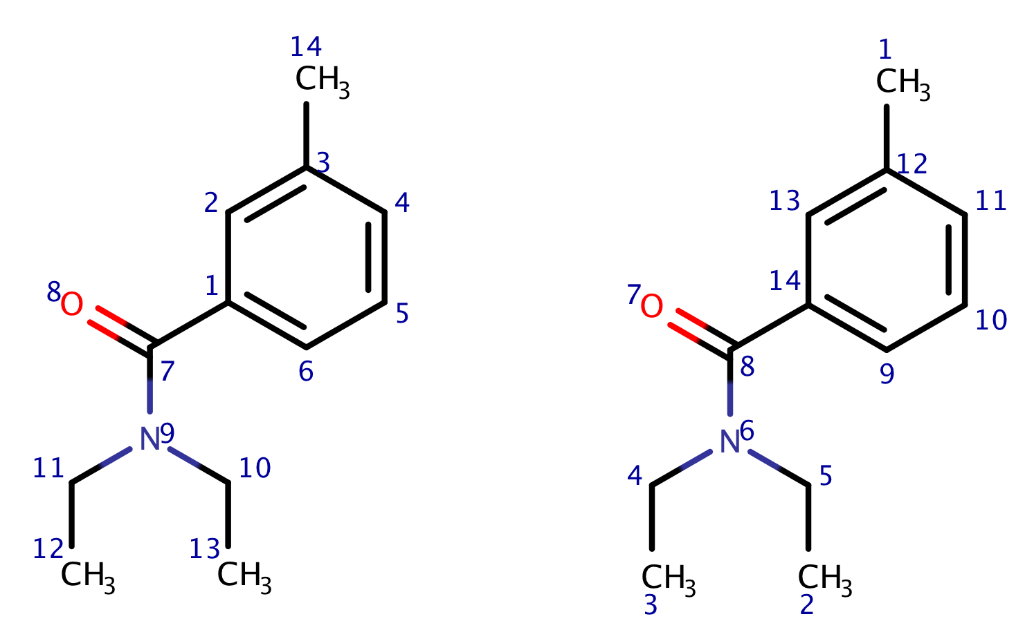
The annotation process
We use SDF because it saves the coordinates and indexing of the atoms
This way, it is easy to identify atom no. 14, which will remain the same, every time the same SDF is used.
WATCH OUT: THE indexing system with probably differ between our SDF file and the file RS-Predictor SDF file, for some compounds
Thus you can paste the two structures in the Marvin Editor and make sure to have the right atom ID.
Examples of discrepancies: N9 (left) = N6 (right
Notes:
BioTransformer is available in JSON

Slide 9

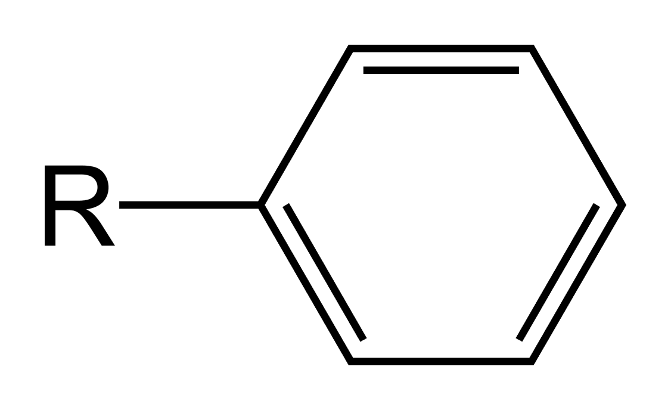
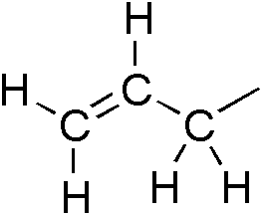
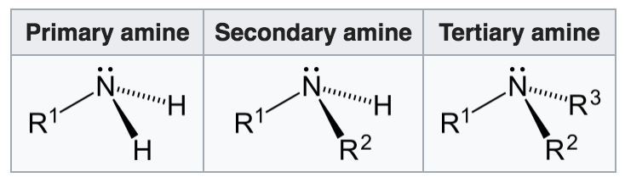
Examples of Functional Groups
In organic chemistry, an alkyl substituent is an alkane missing one hydrogen
aryl is any functional group or substituent derived from an aromatic ring
An allyl group is a substituent with the structural formula H2C=CH−CH2R
Amines are compounds and functional groups that contain a basic nitrogen atom with a lone pair.
Notes:
BioTransformer is available in JSON

Slide 10
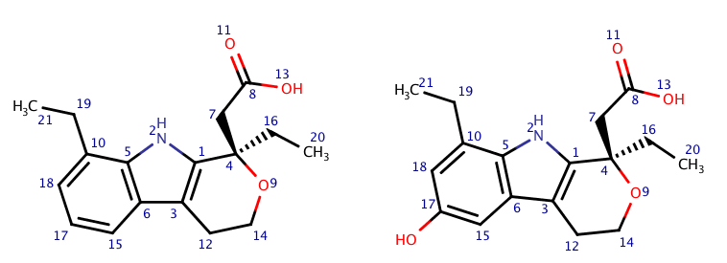
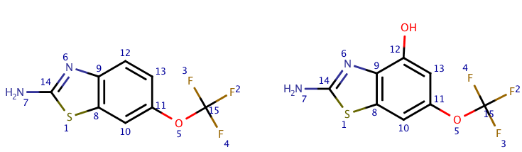
Examples of CYP450 Reactions > Aromatic C-Hydroxylation
Hydroxylation
1) https://en.wikipedia.org/wiki/Hydroxylation
SoM = 17
SoM = 12
Notes:
BioTransformer is available in JSON

Slide 11
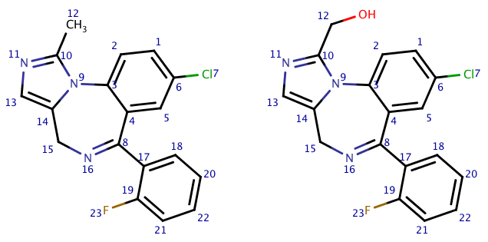
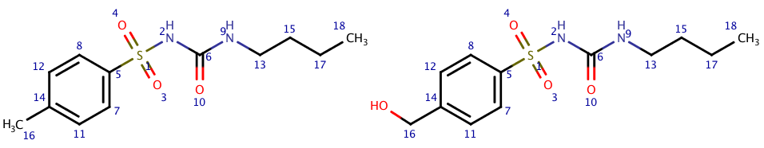
Examples of CYP450 Reactions > Aliphatic C-Hydroxylation
Hydroxylation
1) https://en.wikipedia.org/wiki/Hydroxylation
SoM = 12
SoM = 16
Notes:
BioTransformer is available in JSON

Slide 12
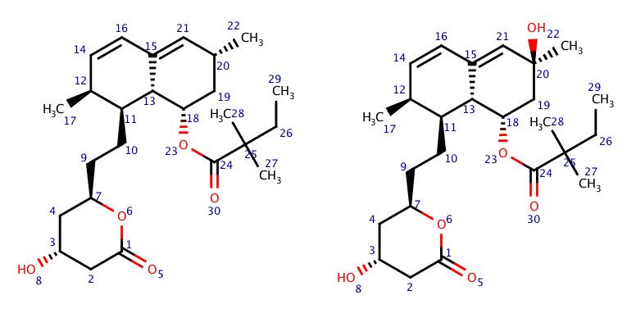
Examples of CYP450 Reactions > Allylic Hydroxylation
SoM = 20
Notes:
BioTransformer is available in JSON

Slide 13
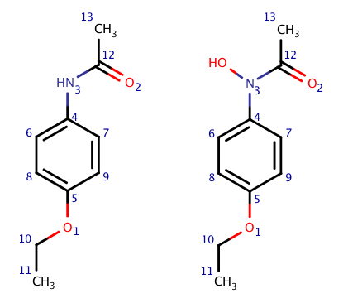
Examples of CYP450 Reactions > N-Hydroxylation
Hydroxylation
1) https://en.wikipedia.org/wiki/Hydroxylation
Phenacetin (SoM = 3)
Notes:
BioTransformer is available in JSON

Slide 14
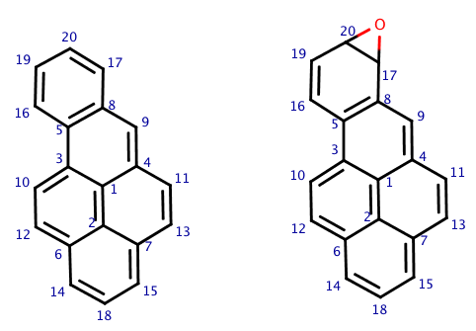
Examples of CYP450 Reactions > Epoxidation
Epoxidation
https://en.wikipedia.org/wiki/Epoxide
Benzo[a]pyrene (SoM = 20, 17)
Notes:
BioTransformer is available in JSON

Slide 15
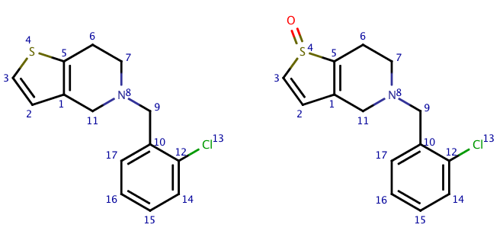
Examples of CYP450 Reactions > S-oxidation
Ticlopidine (SoM = 4)
Notes:
BioTransformer is available in JSON

Slide 16
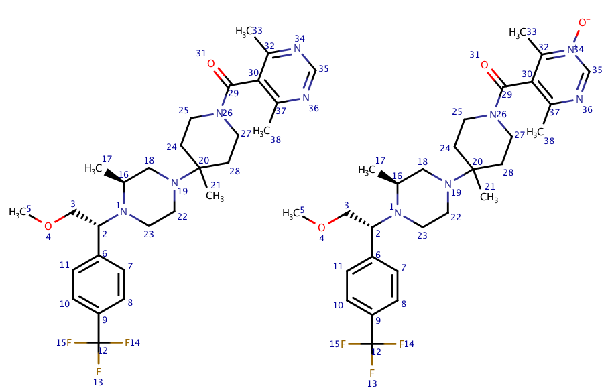
Examples of CYP450 Reactions > N-Oxidation
Vicriviroc (SoM = 34)
Notes:
BioTransformer is available in JSON

Slide 17
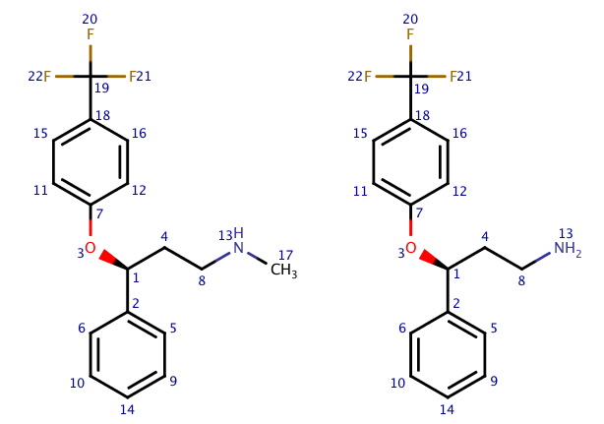
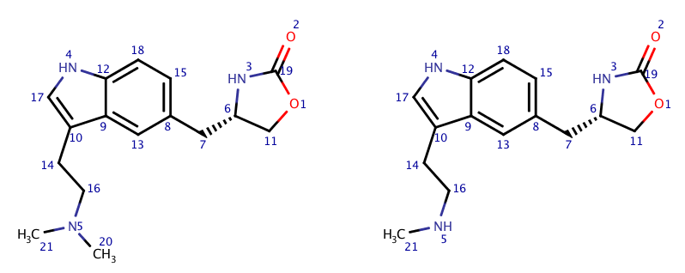
Examples of CYP450 Reactions > N-Dealkylation
zolmitriptan (SoM = 5)
(r)-fluoxetine (SoM = 13)
Notes:
BioTransformer is available in JSON

Slide 18
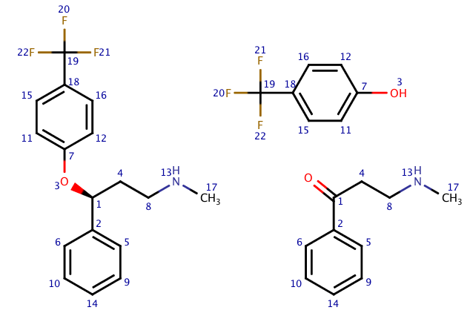
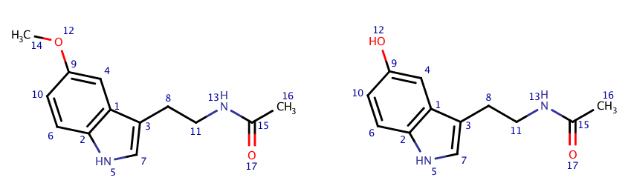
Examples of CYP450 Reactions > O-Dealkylation
(r)-fluoxetine (SoM = 1 or 3?)
melatonin(SoM = 2)
Notes:
BioTransformer is available in JSON

Slide 19
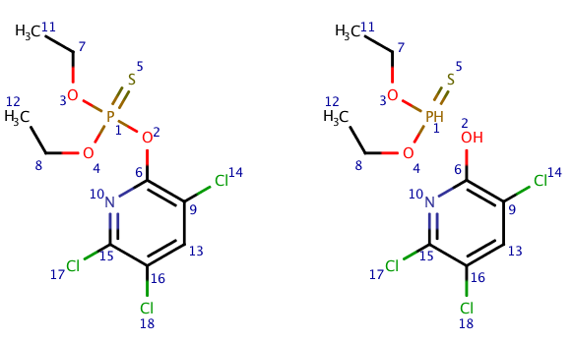
Examples of CYP450 Reactions > O-Dearylation
Chlorpyrifos
Zaretzki et al. report (SoM = 1)
But I think it should be ( SoM=2 )
Notes:
BioTransformer is available in JSON

Slide 20
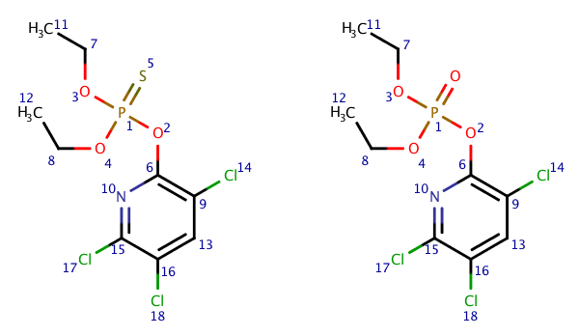
Examples of CYP450 Reactions > O-Dealkylation
Chlorpyrifos (SoM = 5)
Notes:
BioTransformer is available in JSON

